Slide 1




CANADIAN
HOUSING
STATISTICS REVIEW
By Clinton Boyda

Slide 2
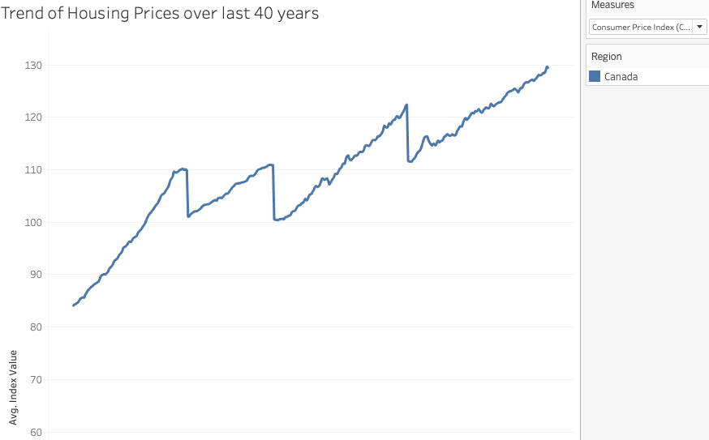


HOUSING PRICES
Trend

Slide 3
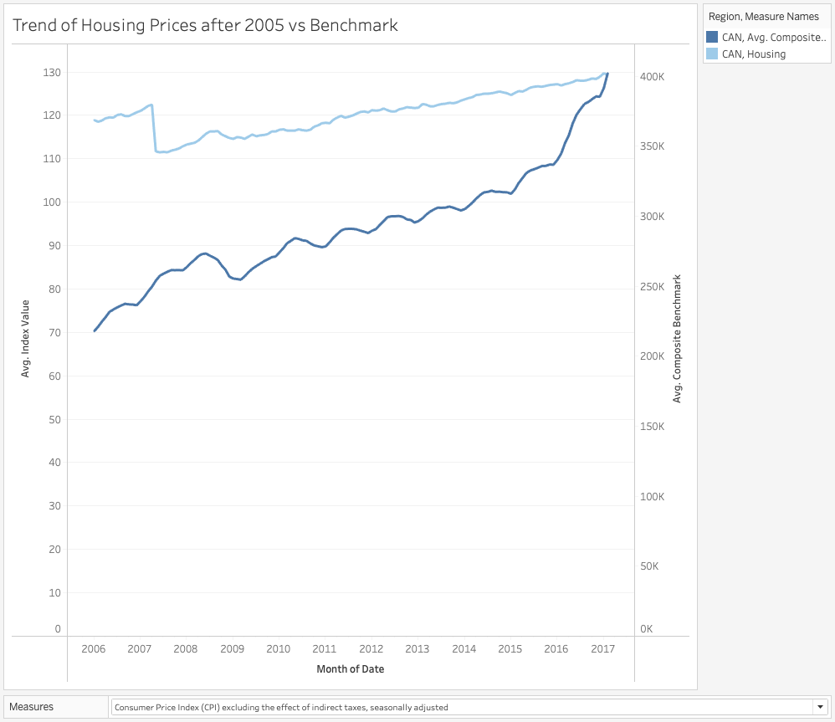

HOUSING PRICES VS BENCHMARK

Slide 4

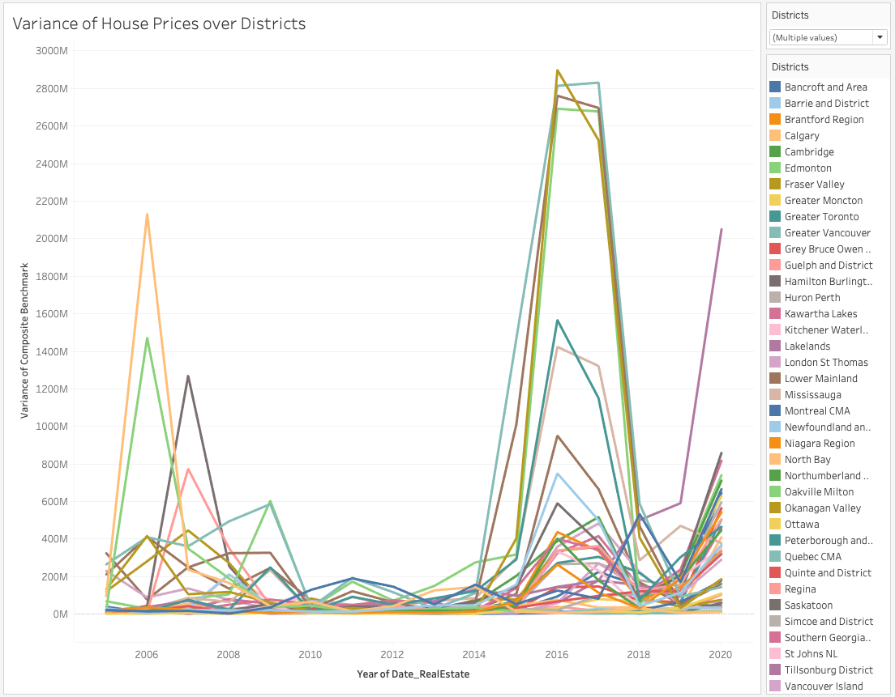
HOUSING PRICE VARIANCE

Slide 5
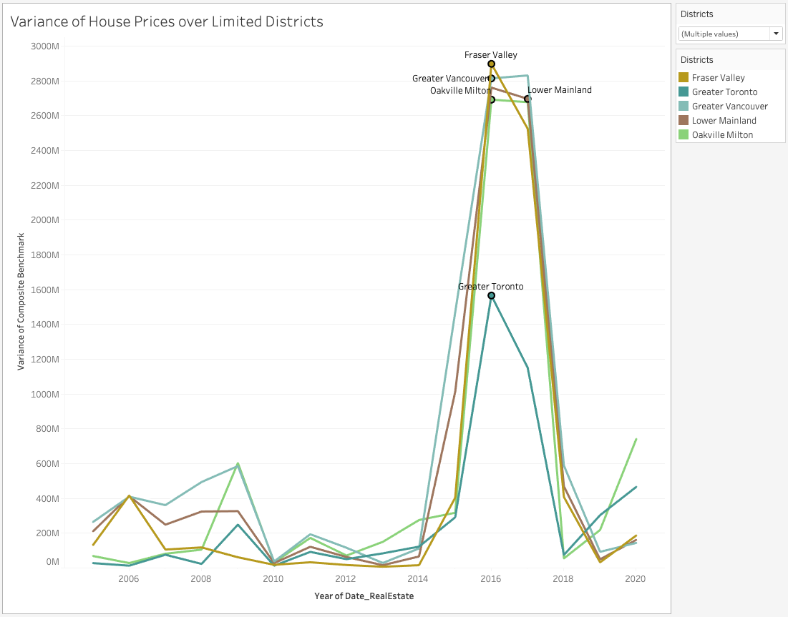
HOUSING PRICE VARIANCE TOP DISTRICTS

Slide 6
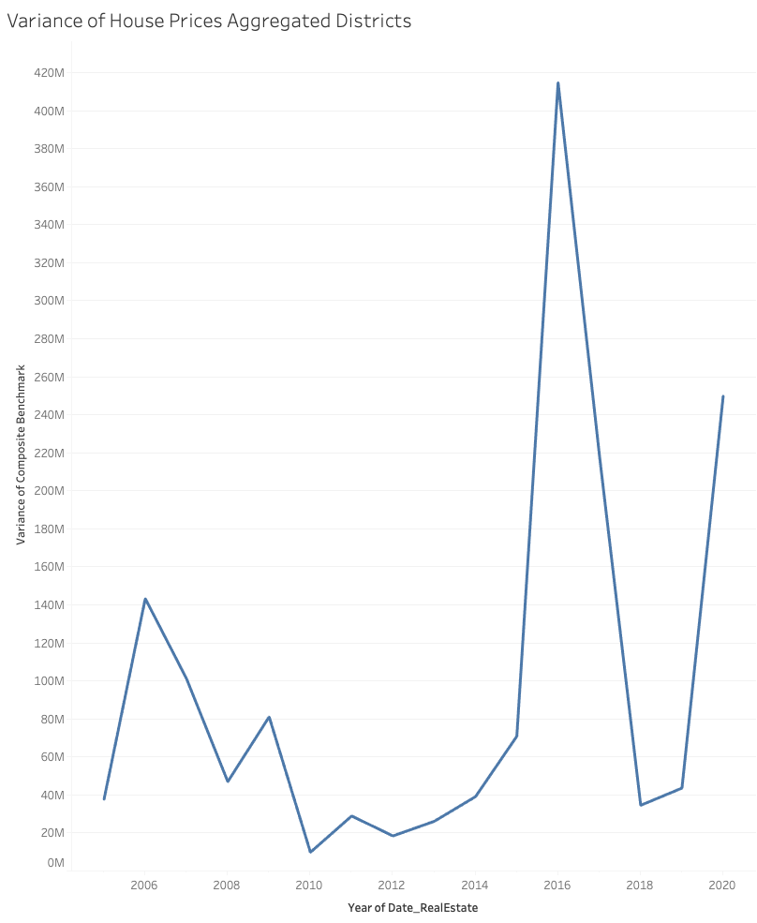
HOUSING PRICE AGGREGATE VARIANCE

Slide 7

WHY DID HOUSING PRICES JUMP IN 2016?
01
ECONOMIC FACTORS
Influenced by strong economic growth,
low interest rates, and favourable employment.
02
SPECULATION & INVESTMENT
Potentially influenced by speculation and investors interested in the housing sector.
03
GOVERNMENT POLICIES
Mortgage regulations, buyer taxes and first-time homebuyer can all impact housing prices.

Slide 8


CONSTRUCTION
OVERVIEW

Slide 9
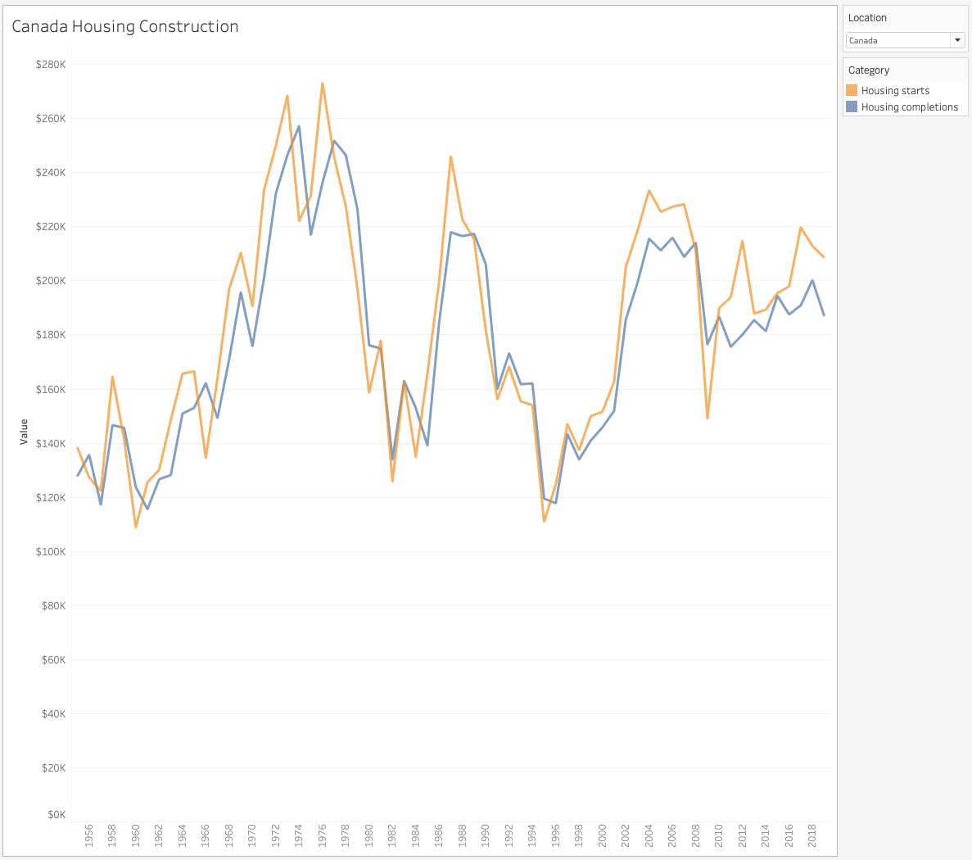
CONSTRUCTION STARTS/DONE

Slide 10
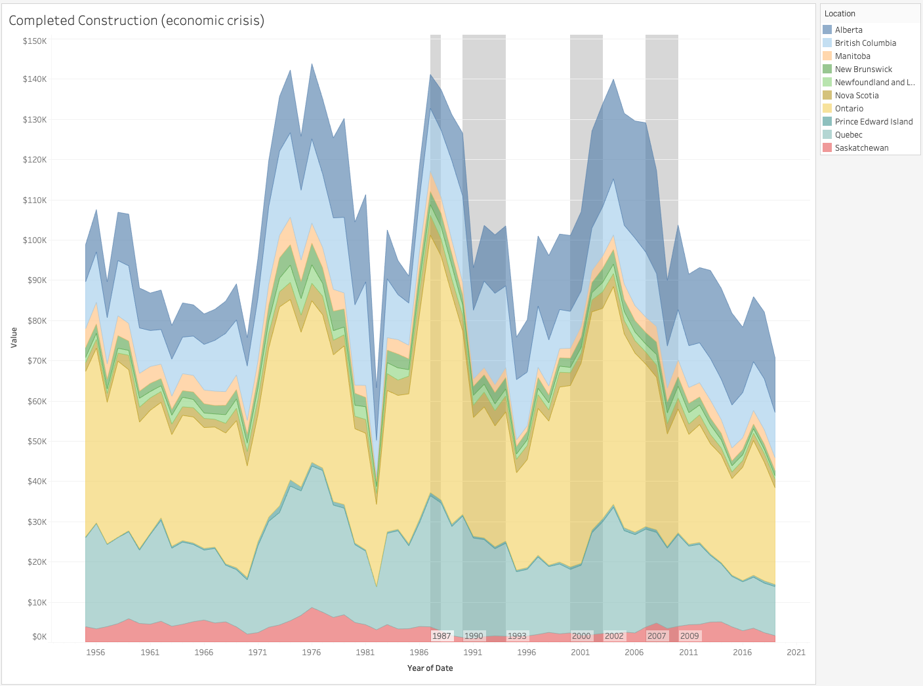

COMPLETED CONSTRUCTION
GLOBAL FINANCIAL CRISIS 2007-2009
Originated in the USA with the collapse of the subprime mortgage market.

Slide 11
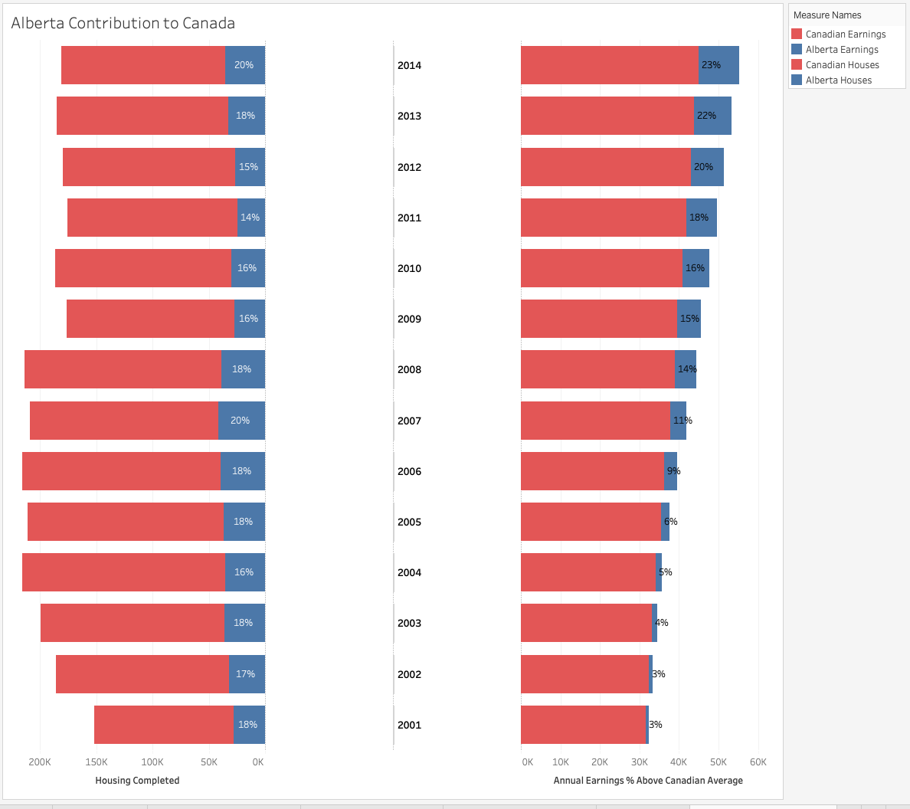
ALBERTA VS CANADA

